Slide 1
Simulations && Sensors
🐦 - @blit12_

Slide 2
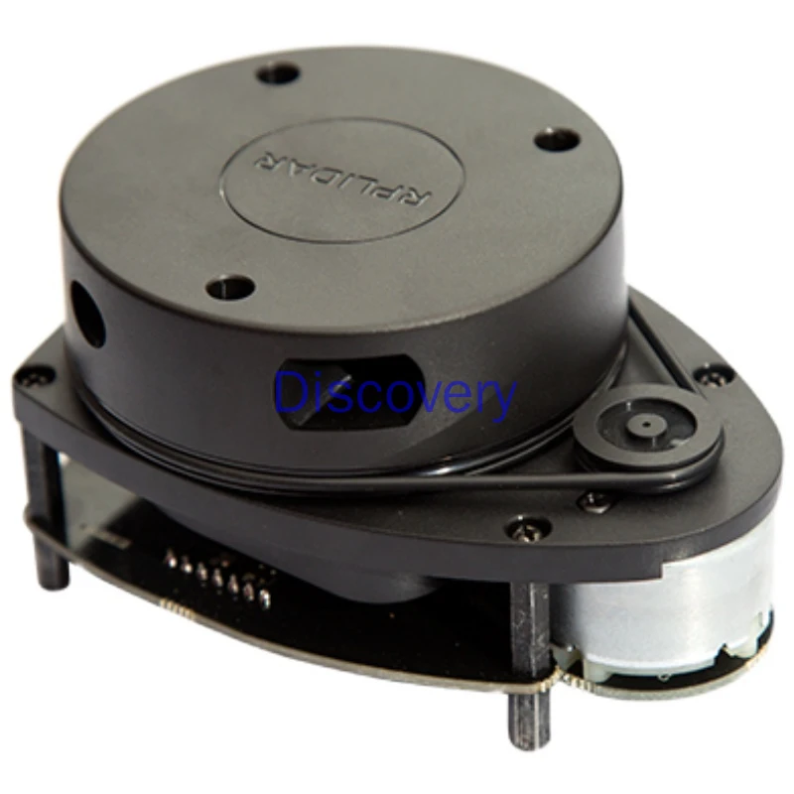
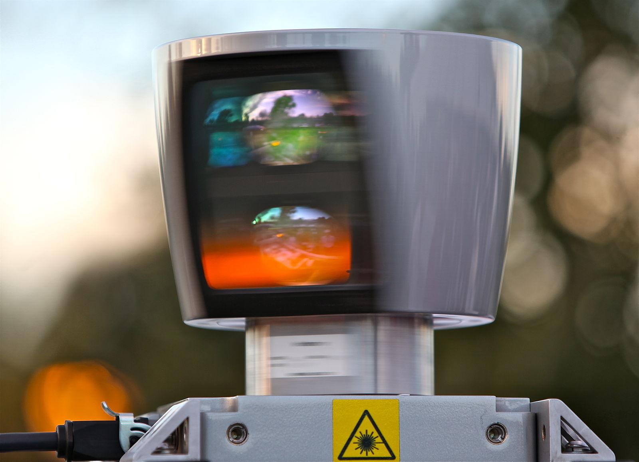
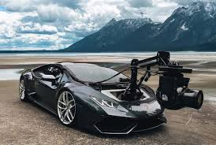
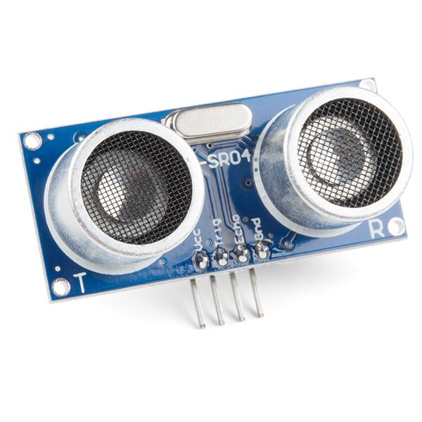
Sensors & Sensor Fusion
Notes:
There are lots of sensors out there in the world, but we are gonna focus on those ones which are used in cars.
Lidars (velodyne $75k, $20 on aliexpress)
Cameras (like that transformer)
ultrasensors (like radars)

Slide 3
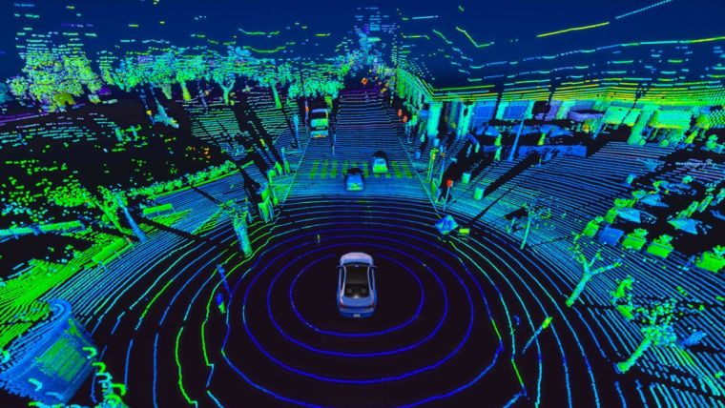
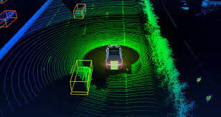
LIDAR
I think this video is pretty awesome and he is very smart: https://www.youtube.com/watch?v=xSrjtJ2AZqw
Notes:
Lidar is a sensor use in almost any autonomous car, except tesla. It uses light to gather information from the environment. When using one of this, you must be careful, because if it is not properly configured, you can cause someone blindness (remember light is no joke). Of course, types of sensors are well adjusted and the ones that you can buy does not use a high frequency. So, why does this sensors are used? Well, as I said earlier, it uses light, the way it works is:
The light beam is sent.
The beam touches something, and reflects on it.
The receiver catches the beam.
Now you have data.
This sensor is pretty accurate and pretty good since it has a large range and the loss of information is poor. It sends a lot of beams, like a sprayer!! AJAJAJA and is pretty awesome because with the information you receive, you can “print” the entire space where it was gathering data. So, if we mix this sensor with, for example, the camera, we can get a super awesome accuracy for object detection, and you also have a 360º view. Lidars are also used in other areas becuase you can map a space with these beams, since the information you get are points in the area, so you get a 3D space.
The downsize is that it is the data processing and cleaning for all the information/data from the beams, which is a lot, of course the velocity can be adjusted, but it gives massive information, so you have to be careful or the memory may get drunk. Another inconvenient is that you have to be careful how you position the lidar, you can get blind points!!!

Slide 4
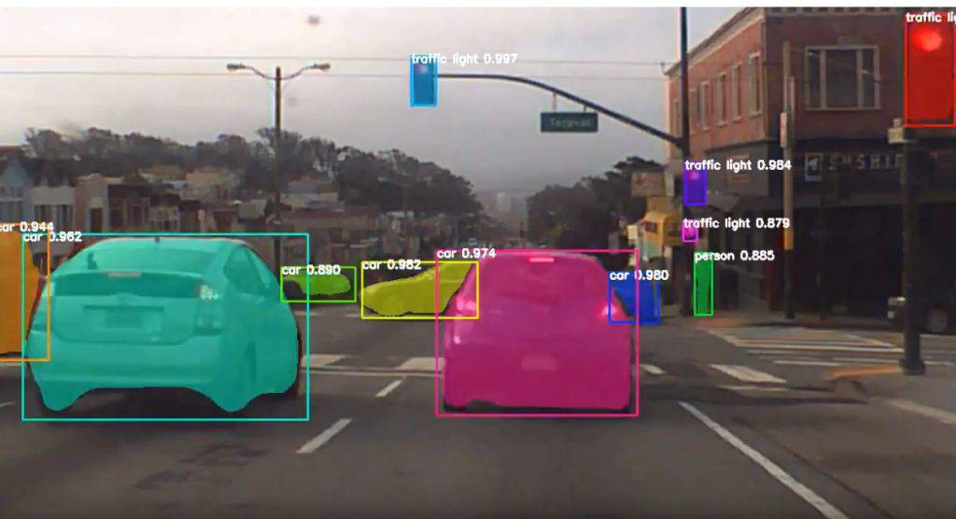
Camera
Notes:
This sensor is widely used, because is the best way to detect with using object detection what is what and where are things, so that you can keep track of it. But it has a handicap, the computer cost is huge sometimes, depending on different things like the model, the number of cameras, the way you treat the camera image, or even if you want to generate a 360 view with cameras at different positions like tesla does, it has some extra steps that could stress the GPU or, in cars what is called TPUs (Tensor Processing Units) that are dedicated hardware for this kind of things, they are super fast.

Slide 5
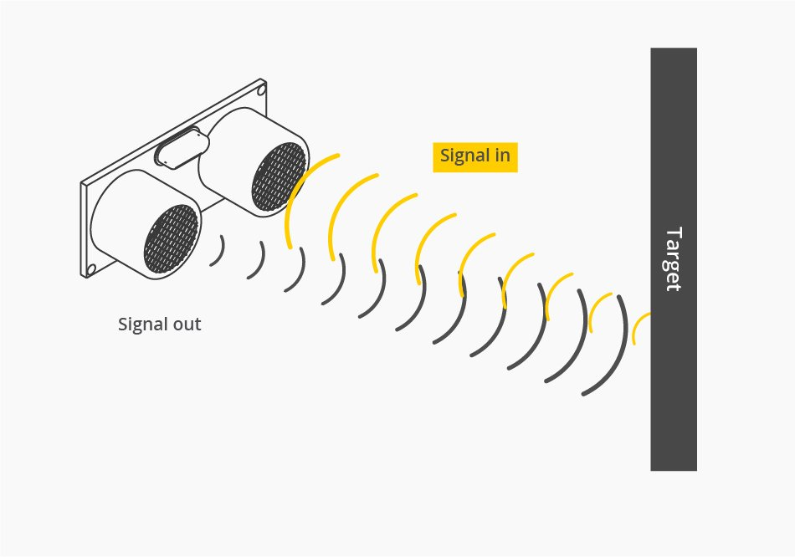
Ultrasensor
Notes:
Ultrasensors like distance sensors are very good for near distance, you can combine with LIDAR. When Lidar cannot get information from that point, the radar can, so you can get the distance of where the other object is.

Slide 6

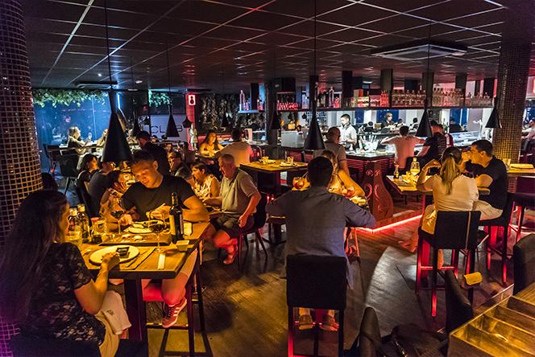
What is sensor fusion?
Notes:
Sensor fusion is the combination of data from sensors to generate information which is more accurate and less uncertainty. Like the song pineapple pen or Fusion restaurant xD

Slide 7
Simulators

Slide 8
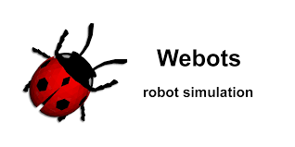


Some simulators
Notes:
Simulators are widely used in robotics, they can help companies and people interested in this world to create and test thing with no need of buying/assembling hardware. We have Gazebo and Webots. I have used webots for starter things and is quite good && light, the Tree view is not the best for me, it makes me angry sometimes. But it is pretty good, and the other one is Gazebo. We are going to use webots in out labs.
These simulators give a pretty good customization of environments as well as creation of controllers. Also, webots is opensource!
Simulators are good because of the abstraction layer that give you. But they are not enough when you need to create/manipulate complex simulations. that is why ROS (Robot Operating System) exists. It is a layer between the hardware and the simulator, with it you can test your drivers in the simulation and then use that same code in the hardware. There are 2 versions of ROS, ROS1 which is kind of deprecated these days and ROS2 which is being used anywhere and is better than ROS1. Both, gazebo and webots are compatible with ROS. Inside ROS2 there are different “flavours”, that I think is because each “flavour” is more like a new version, but IDK. We are not going to use ROS in out labs, sorry!!!

Slide 9
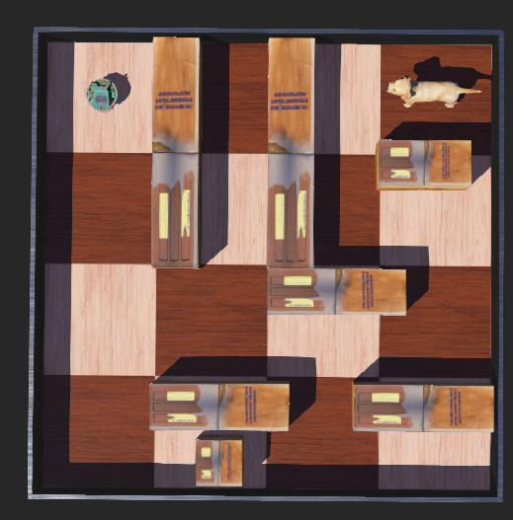
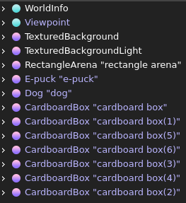
Webots basics
Notes:
This is what we are going to build on this lab. It is a simple e-puck with ultra sensors and shock sensors. A maze and a dog that has to touch. We could prompt something when it touches the dog, but meh, you do it : D
So, webots… it is a good environment, but to be true, the hierarchy is a bit confusing, because, when you see it, is something like (second img). Webots is composed of nodes. Each node has some properties. An advantage of webots is that you can program it in python, c++, java (pug 🤢) and more. You can learn more here basics, and a bunch of tutorials.

Slide 10
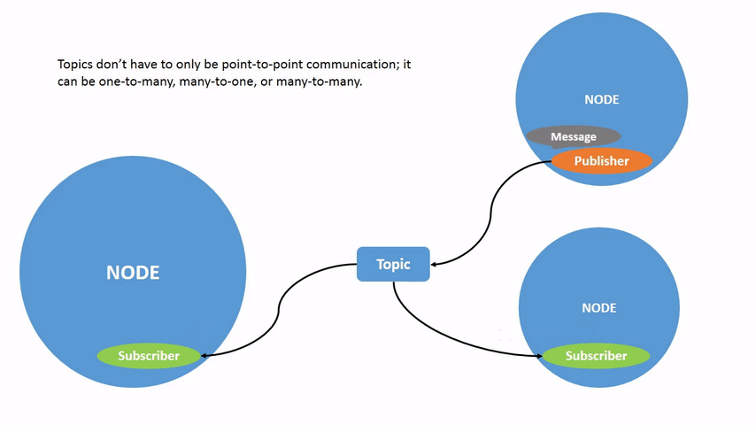
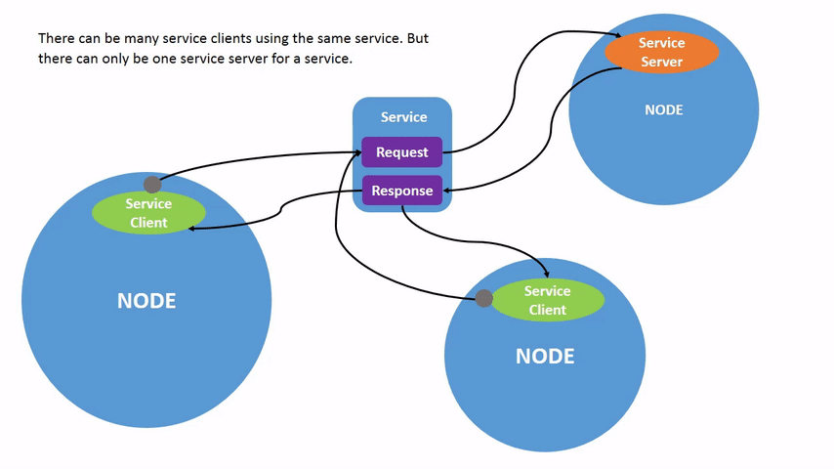
ROS basics
Notes:
ROS (Robotic Operating System) is a bunch of libraries that help you build drivers for the components of your robots, as well as other stuff. ROS has an awesome infrastructure, at least that is what I think. There are two versions of ROS. ROS1 and ROS2, as well as “flavours”. ROS2 is awesome. It has message-server, publisher-suscriber, and a bunch more of architectures that are very useful. We are not touching this on the workshop, but I encourage you to try and do something fun with ROS2 and webots.

Slide 11
Extra things for you
https://www.csail.mit.edu/news/more-efficient-lidar-sensing-self-driving-cars
ROS2 humble documentation
Webots user guide

